Slide 1
Introduction to React
[ Instructor Name ]
[ Instructor E-mail ]

Slide 2
What is React?
React is "a JavaScript library for building user interfaces"
Focus is on JavaScript code, not HTML templates
React Components are composable
One-way reactive data flow, does not perform two-way data binding by default
Efficiently handles DOM manipulations through a Virtual DOM using an algorithm which determines the optimal set of manipulations based upon the changes needed
Represents the "V" in MVC

Slide 3
What is React?
React is not a framework, it only provides support coding UI elements
React does NOT:
Manage application state
Manage asynchronous operations
Process business logic
Provide a controller, routing or other such similar features
Provides local storage mechanisms
Provides a mechanism for services and dependency injection

Slide 4
ES2017, ES2016, ES2015…
Typically, React development is done with the latest and greatest JavaScript features
Support for these cutting-edge features, especially when running React applications in older browsers, is provided by a transpiler such as Babel or TypeScript
Because JSX, a little language which simplifies the development of components, requires a transpiler, it makes sense to use the transpiler for the whole application to gain access to the latest JavaScript features such as ES2015 modules, arrow functions, classes, etc…

Slide 5
ES2017, ES2016, ES2015…
While Babel is very popular (and used in this class), the TypeScript transpiler provides the same benefits plus strong-typing
Transpilers have become an essential part of the development tool chain in modern JavaScript development
Annually, new JavaScript features are released
Usually, before a new feature is released, transpiler support for the feature provides a mean to use it in an older browser, even before the new feature is a standard

Slide 6
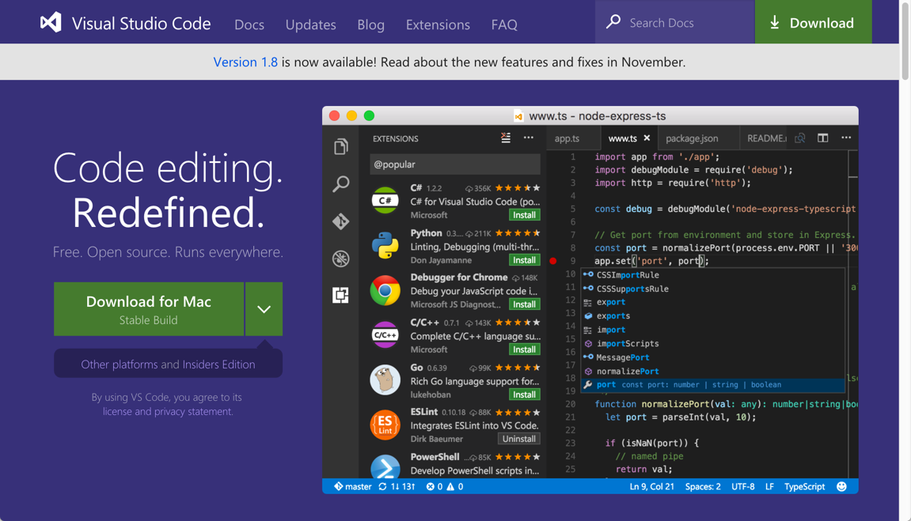
Visual Studio Code
Visual Studio Code is among the most popular editors for coding JavaScript applications
Simply referred to as Code, it provides out-of-the-box support for JSX
Code itself is an Electron-based editor coded with Chromium and Node.js using HTML/CSS/JavaScript
Code is an open-source project
http://code.visualstudio.com (runs on Windows, MacOS & Linux)

Slide 7
Node.js and NPM
Node.js is server-side JavaScript
Node.js and its package manager, NPM, are used to manage the JavaScript packages needed for the development tool chain including React itself
React and the application's JavaScript files are bundled with a tool named Webpack 2
When bundling the files, Webpack 2 runs the files though specially configured loaders such as Babel to transpile the code
Webpack 2 also provides the web development server

Slide 8
Node.js and NPM
REST Services are provided by the JSON Server
Webpack 2 and JSON Server are both built with Node.js and distributed via NPM

Slide 9
Exploring JSX
When a JSX element is transpiled, the result is a createElement call in the outputted code
JSX elements are not HTML and they are not string content, the elements are nested function calls
JSX looks like HTML, which allows the developer to think of the UI structure as a traditional HTML markup structure, but under the hood the elements are only function calls
JSX | <h1 id="page-header">App Tool</h1>
JavaScript | React.createElement('h1', { id: 'page-header' }, 'App Tool')

Slide 10
ES2015 Modules
Originally, JavaScript did not support the usual structures for building large applications such as namespaces or modules
Over the course of time, several patterns emerged for organizing applications into modules: AMD (asynchronous module definition) and CommonJS
Most developers know of AMD through one of its popular implementations Require.js; and CommonJS is used by Node.js
While both module systems are still used today, the JavaScript specification (ES2015) now has support for modules which will be referred to as ES2015 Modules

Slide 11
ES2015 Modules
Through the use of Babel and Webpack 2, ES2015 Modules are available to developers
When React is installed in the application via NPM, it can be easily imported using the import syntax of ES2015 modules
An application grows with numerous component and other classes, each class receives its own file, and can be imported by other files if the class is marked with the export keyword

Slide 12
Fetch API
To retrieve data from REST services, the fetch API will be used
The fetch API is a replacement for the XMLHttpRequest (XHR) object
The fetch API makes no assumptions about the data transfer format
The fetch API is not an official standard yet, but it is supported by many modern browsers, and a polyfill is loaded in our project to make the API available in older browsers
The Webpack 2 configuration for the lab project makes a fetch polyfill available for browsers which do not support it natively

Slide 13
React Component Data
React Component data is one of the most important aspects of working with React
Components utilize three kinds of data: props, state and context
Props, state and context indicate the relationship of the component to a particular data

Slide 14
React Component Data
Props represent data passed from the application or a parent component, and within the component receiving the data, the data is considered immutable
State represents data local to a component, and mutable only within that component, but the component may pass the data as props to a child component
Therefore, data which is state in a parent component, may be props in a child component
It’s the same data in both places, but each component's relationship to the data is different: the parent component can mutate, and child component cannot mutate

Slide 15
React Component Data
Component
State is local to each component. State can only be directly referenced and mutated from within the component to which it belongs
Props data originates from outside the component tree from the application
state
props
render
props
Component
state
context
Context can be thought of as a global scope within the component tree, its use should be limited
Props + State may be passed in as Props to a child component, data which is state in one component, can be be props in the child component
render
props
Component
state
render

Slide 16
Composing React Components
In addition to managing component data, the other critical concept of working with components is how to compose them
While a single React component can contain the entire UI, this is not a best practice
Instead, large UIs should be decomposed into many smaller components, which are then composed together to form a larger UI
The flow of data between parent and child components is critical:
Parent passes data to child component via props; data is immutable to child
Child passes data to parent via events; data is used to update the state of the parent, or is passed up the component tree

Slide 17

Composing React Components
This is the most important concept of Component Driven Development as it
applies to all modern component based frameworks/libraries such as React
Parent Component
Input Properties
Output Events
Input Properties are typically data values and event handler. The child component receives the parent data input, and uses the parent event handlers to communicate data to the parent
Events from within the child invoke the event handlers from the parent. The child passes data to the parent through arguments passed to the event handler when invoked
Child Component

Slide 18
Hands-On Lab
Introduction to React.html

